Slide 1
End-to-End Swara Segmentation and Identification in Indian Classical Flute Melodies: A Deep Learning Framework with Comparative Analysis of Acoustic Features
SUBMITTED BY
SUPERVISOR
Akash Datta Roni
2020331550
Misbah Al Mamun
2020331553
Md. Abu Naser Majumder
DEPARTMENT
DATE
Dept. of CSE,
Sylhet Engineering College
22 August, 2026
01

Slide 2
PRESENTATION ROADMAP
1
Research Background & Problem Statement
6
Experimental Setup
2
Research Hypothesis
7
Results & Discussion
3
Objectives
8
Contribution, Originality & Novelty
4
Related Work
9
Conclusion
5
Methodology
10
Future Work
02

Slide 3
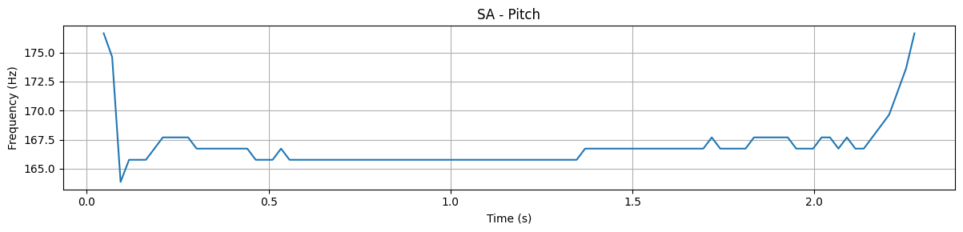
1
RESEARCH BACKGROUND
Why Automatic Swara Transcription?
Indian flute melodies exhibit distinctive melodic characteristics
Limited annotated data
Deep progress for Western instruments (e.g. piano) vs. limited work on Indian classical instruments
Manual transcription is expensive
Helps preserve musical knowledge
Illustrative: pitch contour of a single swara (Sa)
03

Slide 4
4
RELATED WORK
Prior Work at a Glance
Study | Approach | Key Limitation / Gap
Devansh P. Shah et al. | Raga Recognition in Indian Classical Music Using Deep Learning | Uses only raw spectrograms, doesn’t experiment on swara level
Christian Schörkhuber et al. | Instrument-agnostic CQT-based multipitch model | General-purpose; not tuned to swara-level classification
Yu-Te Wu et al. | Attention in multi instrument automatic music transcription | Uses attention in ATM with pitch only
Ruimin Wu et al. | Piano Transcription with Harmonic attention | Uses attention in piano, a polyphonic instrument
C Duxbury et al. | A hybrid approach to musical note onset detection. | No explicit boundary times — sequence-only prediction
07

Slide 5
RELATED WORK
4
The Research Gap
1
2
3
Limited research on automatic swara identification in continuous flute melodies
Lack of robust note-boundary detection for continuous flute recordings
Limited exploration of deep-learning features and hybrid architectures for swara recognition
In summary, there aren’t any previous work that relates to our end-to-end pipeline or comparison study.
08

Slide 6
PROBLEM STATEMENT
The Core Problem
Can an end-to-end pipeline for flute-melody segmentation and swara identification be developed using limited annotated data and synthetic melody generation?
1
2
3
Data Scarcity
Soft Onsets
Annotation Cost
Flute swara and melody dataset are very rare, there aren’t any specific for this research.
Flute notes lack the sharp percussive attack that onset detectors rely on.
Manual boundary labeling of note transitions is slow, time consuming and expensive
04

Slide 7
RESEARCH HYPOTHESIS
Three Testable Hypotheses
H1
Low Annotation Cost
H2
Feature Representation
Synthetic melodies can reduce the need for manually annotated continuous recordings.
Log-Mel and CQT should outperform alternative acoustic feature representations as they provide more information
H3
Segmentation
Deep-learning segmentation should be able to accurately detect swara boundaries.
05

Slide 8
OBJECTIVES
Research Objectives
1
2
3
Build a Swara Dataset
Generate Synthetic Melodies
Design a Segmentation Model
4
5
6
Design a Classification Model
Compare Feature Representations
Evaluate End-to-End Performance
06

Slide 9
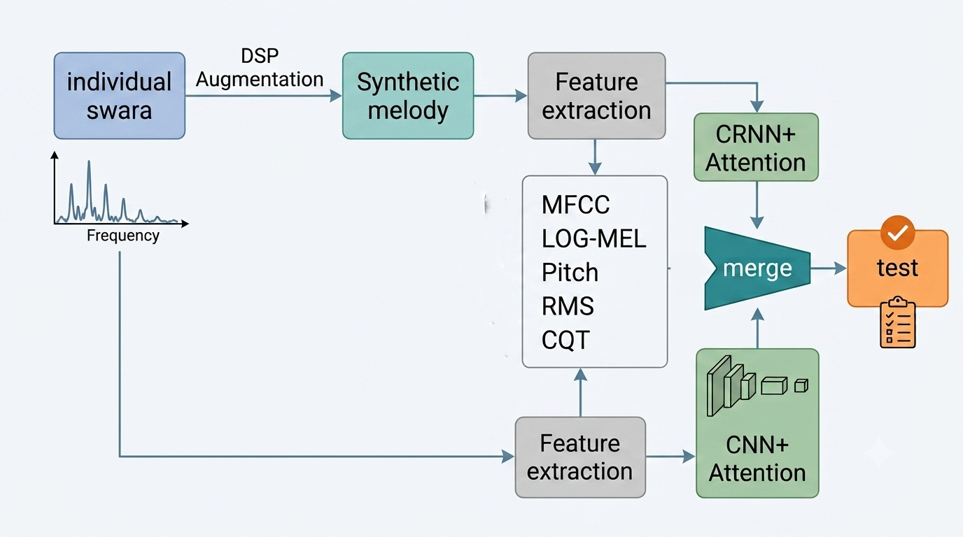
METHODOLOGY
End-to-End Pipeline Overview
10

Slide 10
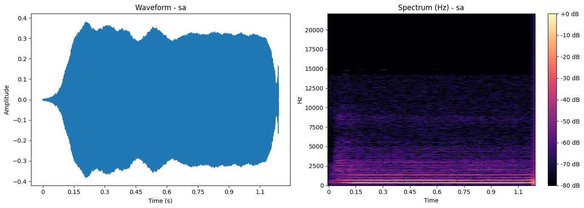

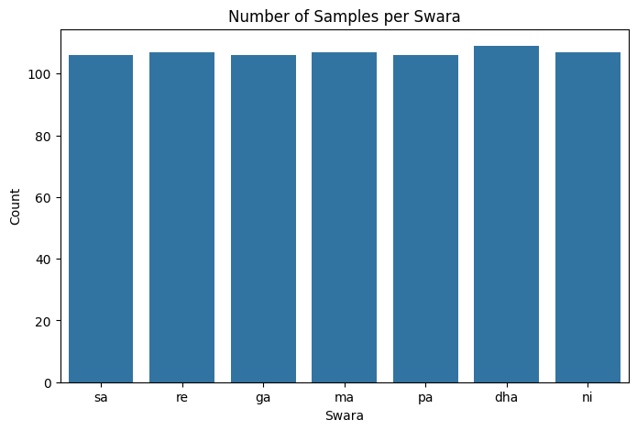
METHODOLOGY
Sa
Stage 1 — Isolated Swara Collection
Individual Swara Dataset
Total recordings
748
Swara classes
7 (Sa, Re, Ga, Ma, Pa, Dha, Ni)
Avg. recordings / class
106.9
Avg. note duration
1.14 s
Median duration
0.97 s
Data source: publicly available + self-recorded audio
09

Slide 11
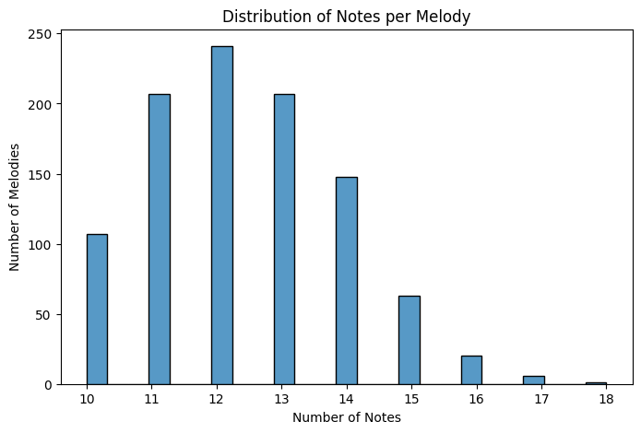
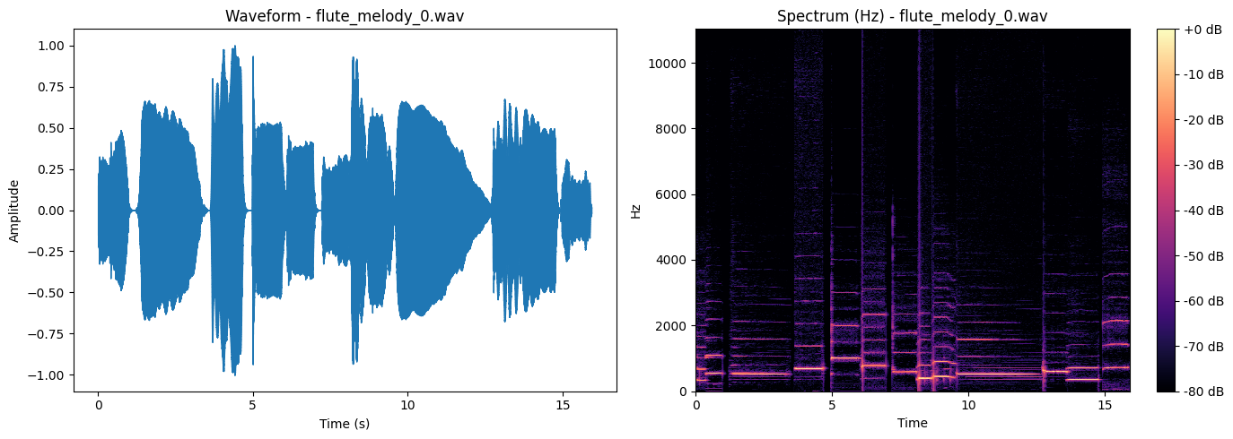
METHODOLOGY
6
Stage 2 — Synthetic Melody Generation
Isolated swara
Randomized Swara Sequences, Natural Silence Gap
Augmentation (Pitch, Amplitude, Slide, Reverberation)
Synthetic Melodies with ground truth
Total Synthetic Melodies : 1000
Synthetic melodies
11

Slide 12
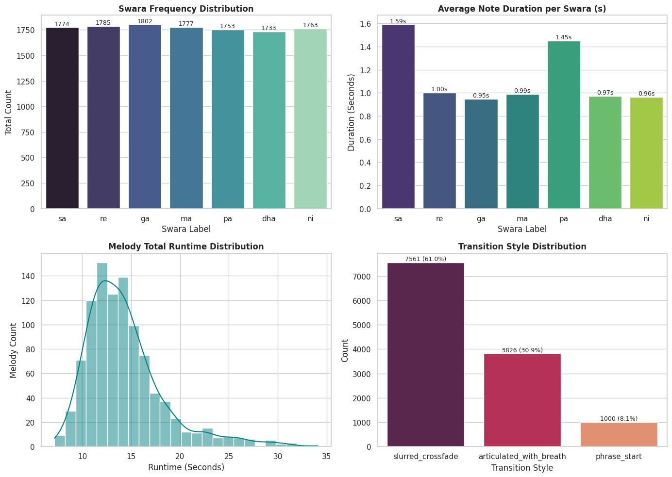
METHODOLOGY
6
Stage 2 — Synthetic Melody EDA
11

Slide 13
METHODOLOGY
6
Stage 3 — Swara Segmentation
Synthetic
Melody Audio
Feature
Extraction
CRNN +
Attention
Predicted
Boundaries
Segmentation Architecture
Model : Convolutional Recurrent Neural Network.
Data : Extracted features from synthetic melody and ground truth data
• Network: attention-based CRNN
• Trainable parameters: [1090594]
• Epochs / batch size / optimizer: [30 / 8 / Adam]
• Output: frame-level boundary probabilities
• Loss function: BCEWithLogitsLoss
Architecture
Model - CRNN (Convolutional Recurrent Neural Network)
Input - Feature tensor of size C × 128 × T
Convolution Block - Two Conv2D blocks with Batch Normalization [48],
ReLU activation, and Max Pooling
Attention Layer – Temporal Attention
Recurrent Layer – Bi-LSTM
Output Layer - Sigmoid activation
Objective – Detect swara transition
11

Slide 14
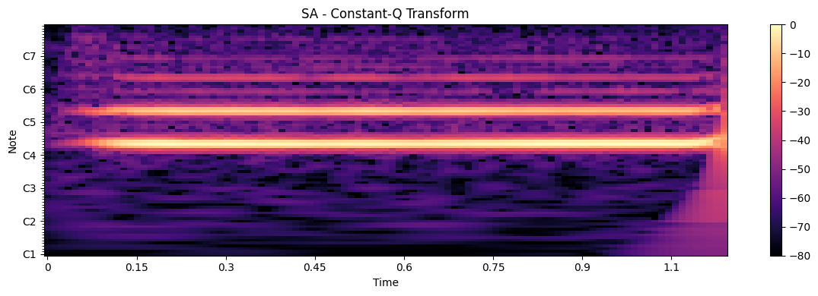
6
METHODOLOGY
Stage 4 — Swara Classification
Classification Architecture
• Network: attention-based CNN
• Input: note-level acoustic feature (e.g. CQT)
• Output: 7-way softmax over swara classes
• Trainable parameters: [101,960]
• Training config: 25 / Adam / Cross-Entropy Loss
Example: Constant-Q Transform (CQT) representation of a single swara
Sa
Re
Ga
Ma
Pa
Dha
Ni
7 target swara classes
12

Slide 15
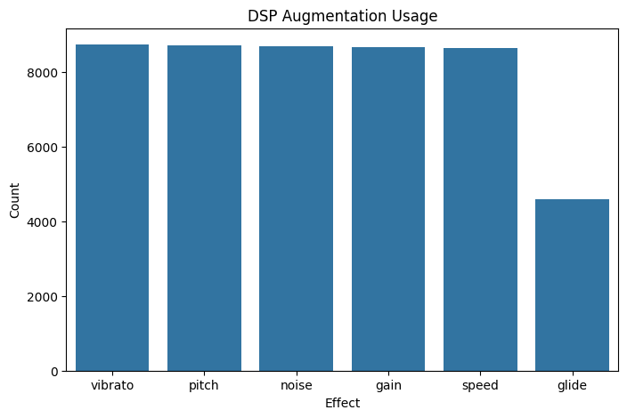
EXPERIMENTAL SETUP
Feature Representations Compared
# | Feature | Captures
E1 | Log-Mel Spectrogram | Spectral + perceptual characteristics
E2 | Pitch | Fundamental frequency only
E3 | RMS Energy | Loudness / energy envelope only
E4 | Log-Mel + Pitch | Spectral + frequency fusion
E5 | Log-Mel + Pitch + RMS | Spectral + frequency + energy fusion
E6 | Constant-Q Transform (CQT) | Log-scaled, musically aligned frequency bins
DSP augmentations applied when generating synthetic melodies (vibrato, pitch, noise, gain, speed, glide)
[Note: all six experiments used identical model architectures & training configuration — only the input feature representation varied]
13

Slide 16
EXPERIMENTAL SETUP
Training Configuration & Evaluation Metrics
Training Configuration
Evaluation Metrics
Parameter | Classification (CNN + Attention) | Segmentation (CRNN + Attention)
Epochs | 25 | 30
Batch Size | 16 | 8
Optimizer | Adam | Adam
Learning Rate | 0.001 | 0.001
Train/validation split | 80/20 | 80/20
Loss function | Cross-Entropy Loss | BCEWithlogitsLoss
Classification Accuracy / F1
Correctness of predicted swara labels
Segmentation Precision / Recall / F1
Frame-level boundary detection quality
End-to-End Segmentation Accuracy
% of melodies with every boundary correct
End-to-End Classification Accuracy
Note-level accuracy on perfectly segmented melodies
14

Slide 17
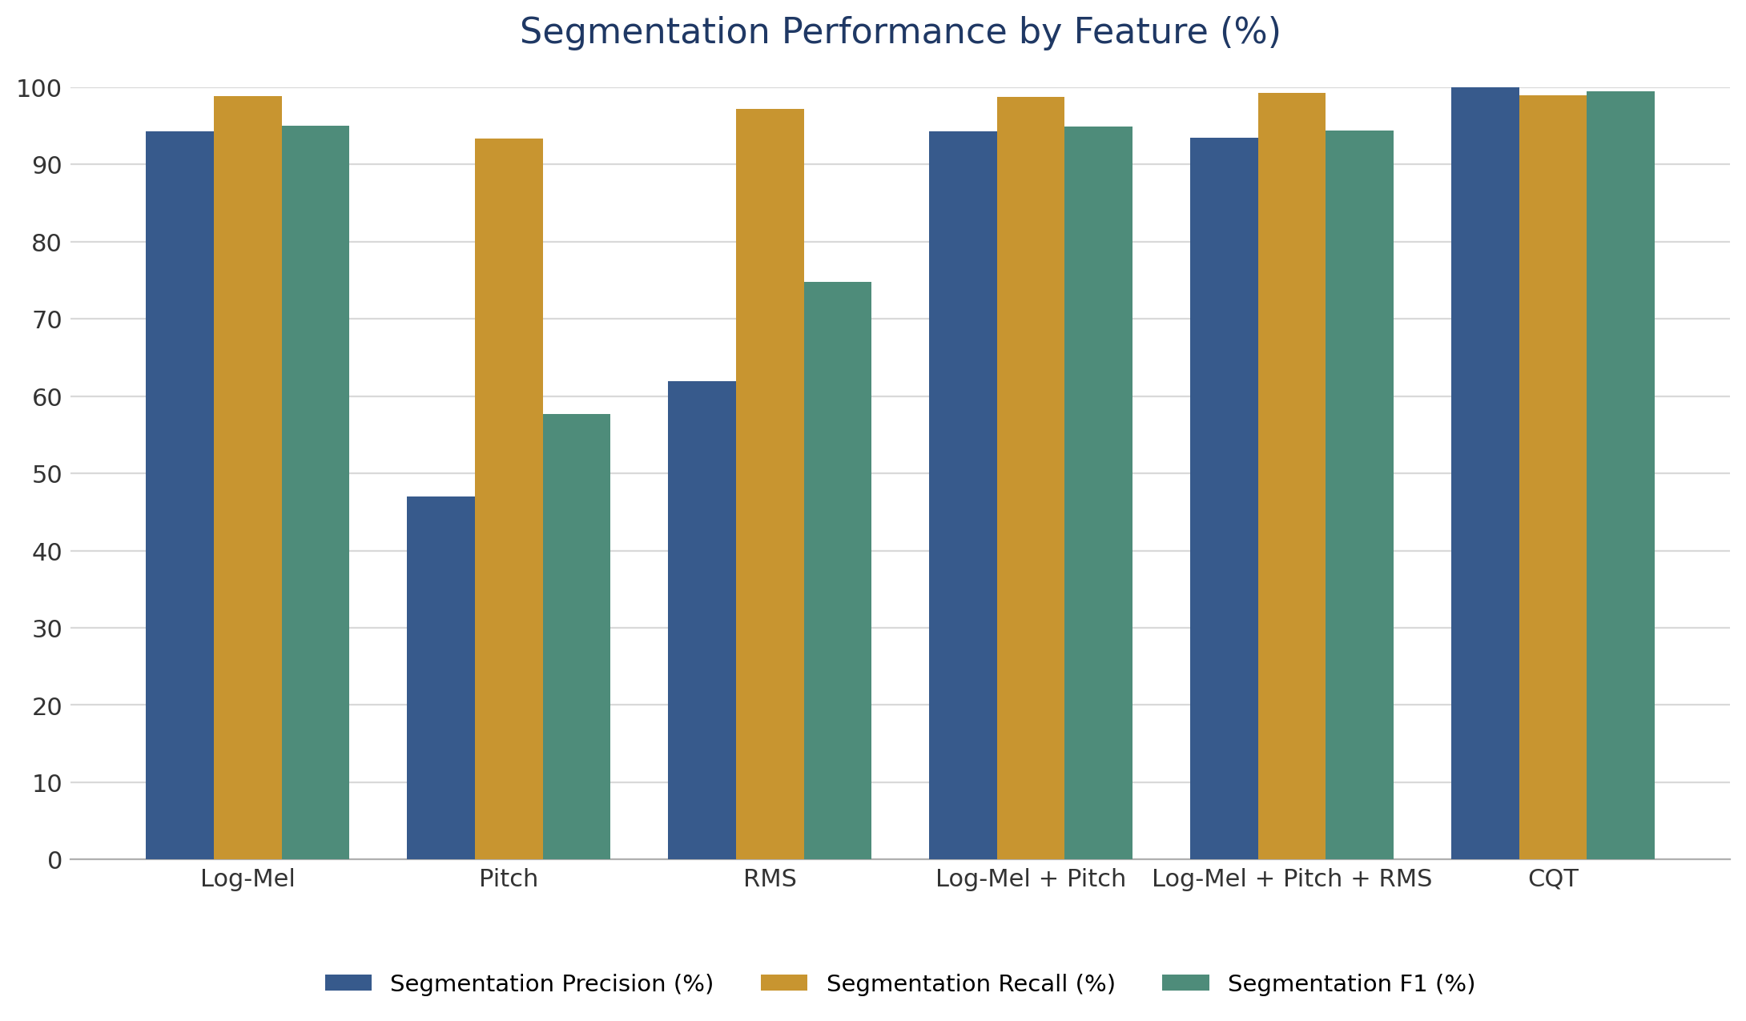
8
RESULTS & DISCUSSION
Segmentation Performance Across Experiments
BEST RESULT
CQT
Precision : 100%
Recall: 98.98
F1: 99.49
15

Slide 18
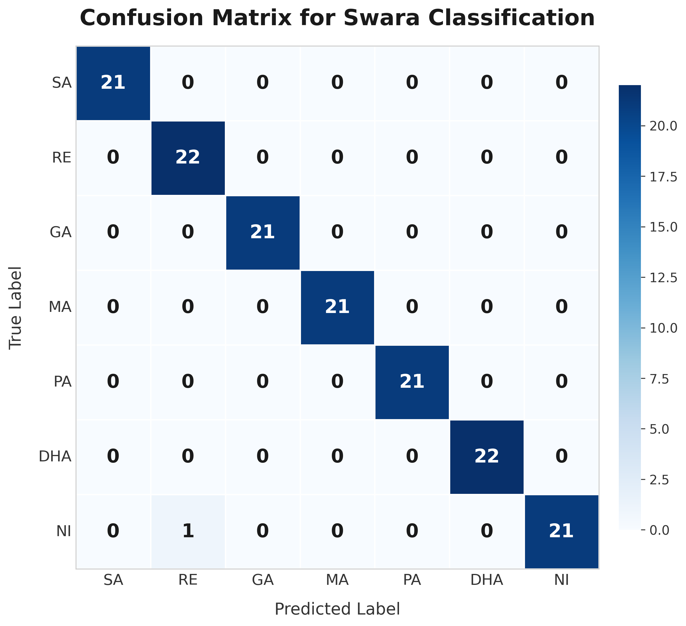
8
RESULTS & DISCUSSION
Classification Performance Across Experiments
Confusion matrix of CQT classification
16

Slide 19
EXPERIMENT RESULTS
Experiment Comparisons
Experiment | Feature | Classification Accuracy (%) | Classification F1 (%) | Segmentation Precision (%) | Segmentation Recall (%) | Segmentation F1 (%) | End-to-End Segmentation (%) | End-to-End Classification (%)
E1 | Log-Mel | 85.00 | 89.30 | 94.3 | 98.9 | 95.0 | 71.43 | 84.29
E2 | Pitch | 69.00 | 71.50 | 47.00 | 93.40 | 57.70 | 40.00 | 21.43
E3 | RMS | 31.00 | 29.60 | 61.90 | 97.20 | 74.80 | 64.29 | 14.29
E4 | Log-Mel + Pitch | 84.70 | 86.50 | 94.30 | 98.70 | 94.90 | 57.14 | 39.29
E5 | Log-Mel + Pitch + RMS | 93.30 | 94.00 | 93.50 | 99.30 | 94.40 | 50.00 | 75.51
E6 | CQT | 99.33 | 99.00 | 100 | 98.98 | 99.49 | 92.86 | 97.80
CQT (E6) is the clear top performer — it achieves the highest scores across every metric (99.33% classification accuracy, 99.49% segmentation F1, 100% end-to-end classification), showing that constant-Q features generalize far better than any single or combined handcrafted feature set.
08

Slide 20
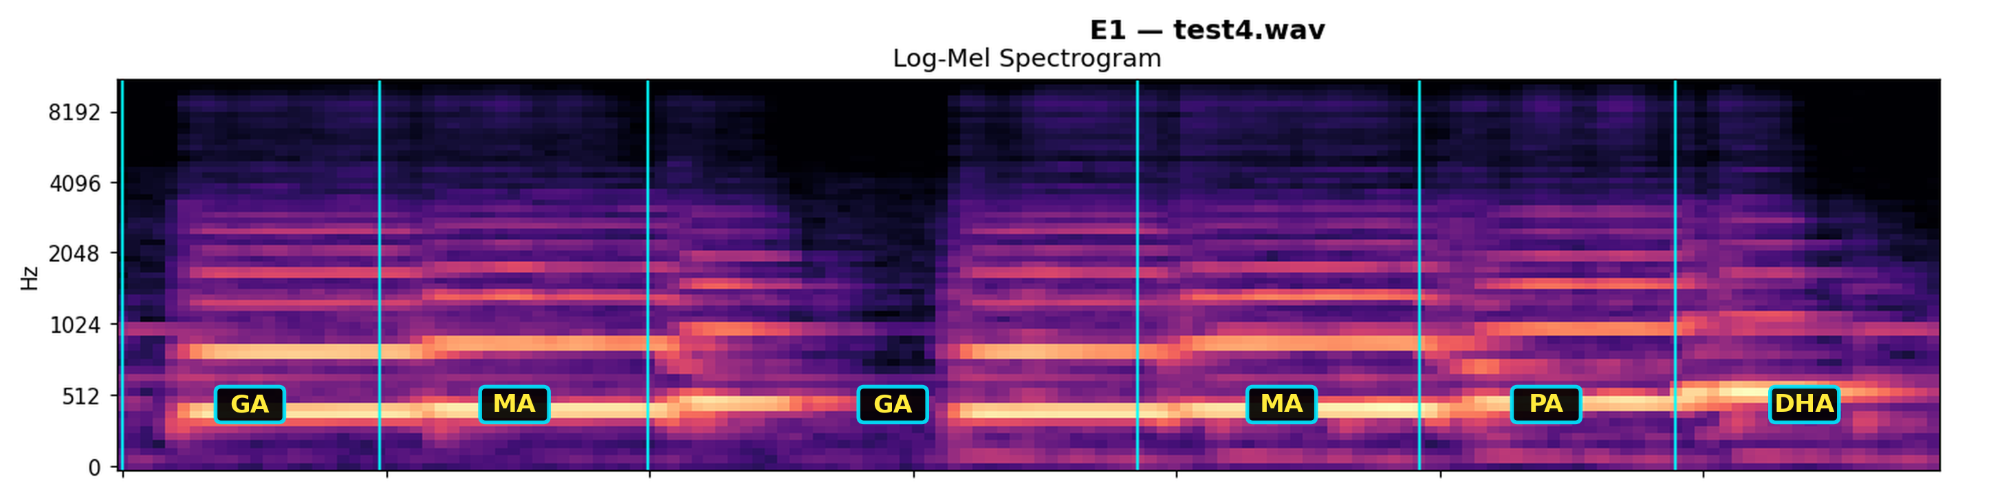
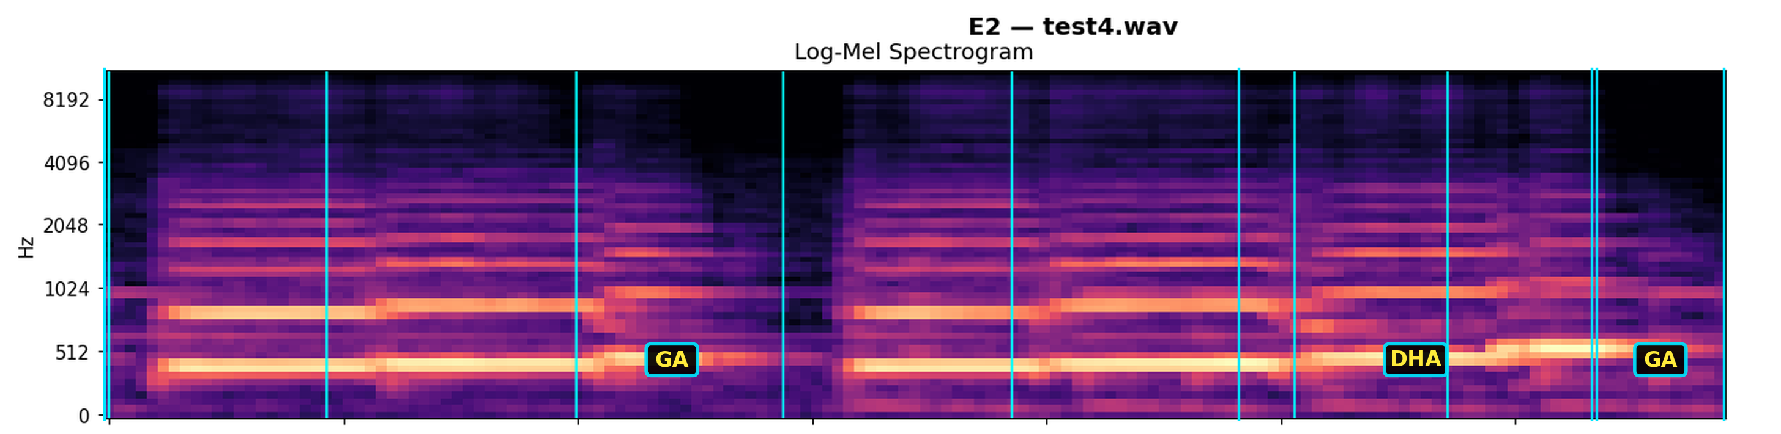
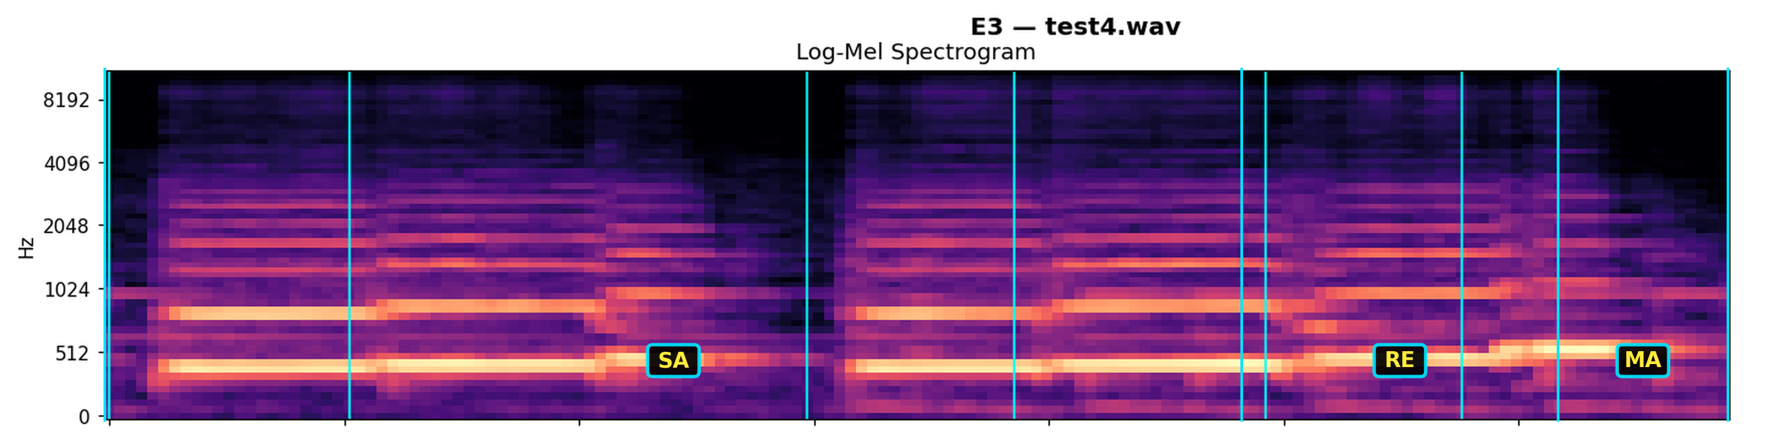
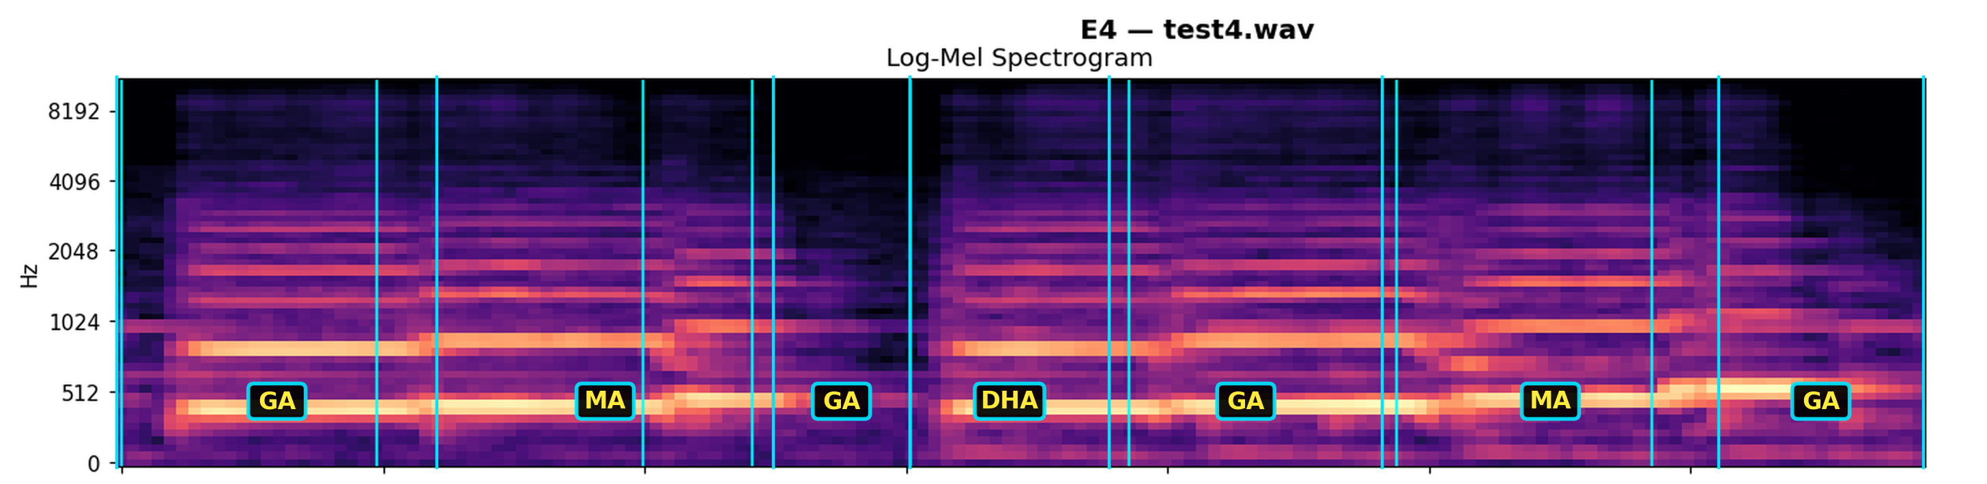
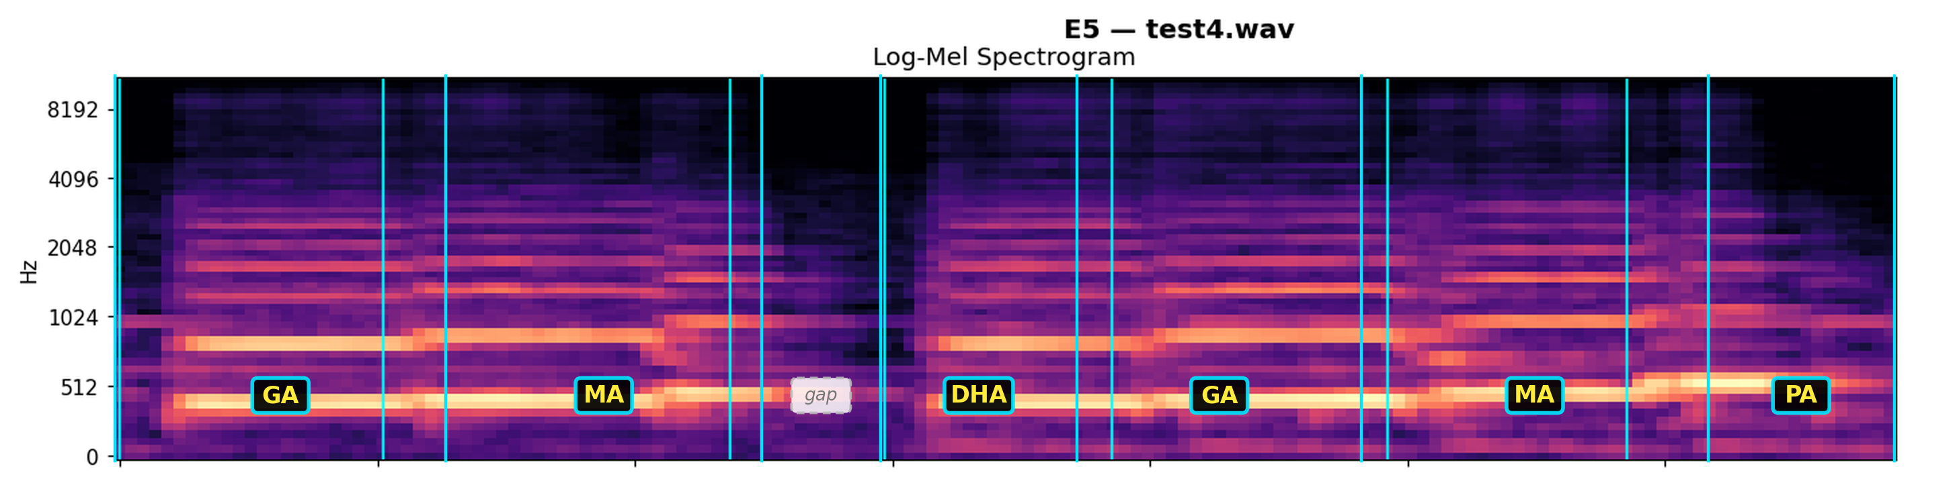
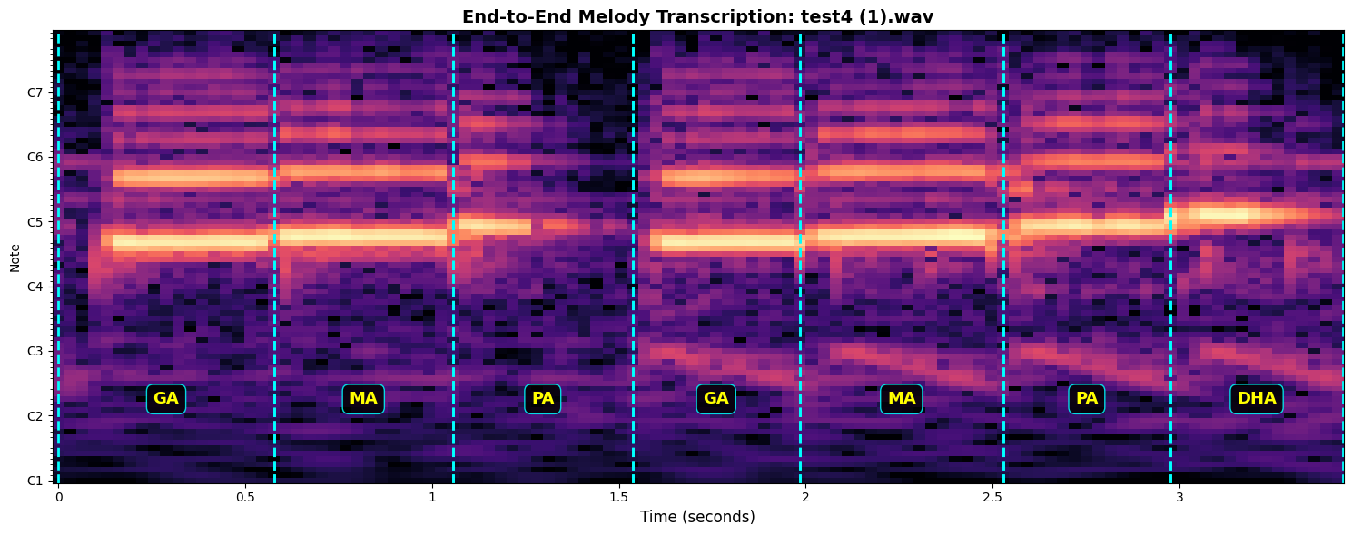
EXPERIMENT RESULTS
Feature Comparison — Predicted vs Ground Truth
Ground truth: Ga Ma Pa Ga Ma Pa Dha
E1 · Log-Mel Close — 1 boundary missed
E2 · Pitch Fails — collapses to 3 guesses
E3 · RMS Fails — collapses to 3 guesses
E4 · Log-Mel + Pitch Fails — repeats & misses Pa
E5 · Log-Mel+Pitch+RMS Fails — mislabels + gap
E6 · CQT Perfect — 7 / 7 correct
CQT (E6): Perfect reconstruction (7/7), accurately capturing every swara change.
Log-Mel (E1): Nearly correct, but merges one boundary and misses a “Pa.”
Pitch/RMS (E2–E3): Poor segmentation, often collapsing into dominant guesses.
Combined features (E4–E5): High training performance but introduce false boundaries and errors.
09

Slide 21
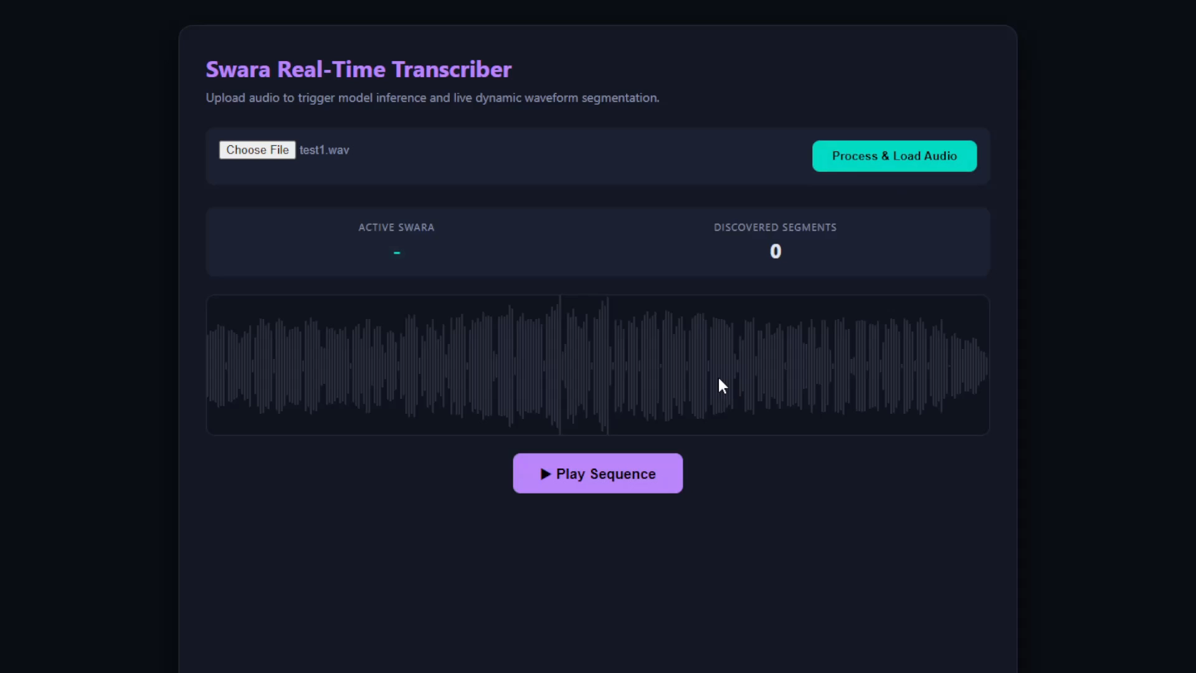
EXPERIMENT RESULTS
Real Time Visualization

Slide 22
8
DISCUSSION
Key Observations
1
CQT consistently outperforms all other representations for both stages
2
Pitch/RMS alone are insufficient — lack harmonic & timbral detail
3
Feature fusion (Log-Mel+Pitch+RMS) narrows the gap but doesn't match CQT
4
Frame-level F1 exceeded 94% for E4/E5, yet end-to-end accuracy was only 57%/50% — because melody-level scoring requires every boundary in a melody to be correct, so small per-frame errors compound across notes.
4
17

Slide 23
CONTRIBUTION AND NOVELTY
Research Contribution, Originality & Novelty
i
ii
iii
First Segmentation Pipeline for Indian Flute Melody
Novel Annotation-to-Synthesis Pipeline
Two Novel Datasets
v
iv
A systematic six-feature comparison
Honest Domain-Gap Diagnosis & Mitigation
18

Slide 24
CONCLUSION
Summary of Findings
92.86%
97.80%
748
End-to-end segmentation accuracy (CQT)
Note-level classification accuracy on perfectly segmented melodies
Isolated swara recordings across 7 classes
• The proposed two-stage, attention-based pipeline achieves accurate swara transcription without large annotated corpora
• Synthetic melody generation with automatic ground-truth removes the manual annotation bottleneck
• CQT proved the most effective feature representation for this timbre and task
• The framework generalizes conceptually to other monophonic instruments
19

Slide 25
FUTURE WORK
Where This Research Goes Next
Extend to other monophonic instruments (violin, recorder, clarinet, saxophone)
Scale synthetic data generation to thousands of automatically annotated melodies
Model expressive ornamentation — Meend, Gamak, Murki, Kan Swara
Explore Transformer / Conformer / self-supervised audio architectures
More realistic synthetic melodies — breathing, dynamics, performer style
Build a complete real-time transcription & notation application
20

Slide 26
KEY REFERENCES
1
Raga Recognition in Indian Classical Music Using Deep Learning
Shah, D.P., Jagtap, N.M., Talekar, P.T., Gawande, K.
In: Romero, J., Martins, T., Rodríguez-Fernández, N. (eds) Artificial Intelligence in Music, Sound, Art and Design. EvoMUSART 2021 (2021)
DOI: 10.1007/978-3-030-72914-1_17 | pp. 248–263
2
Multi-Instrument Automatic Music Transcription With Self-Attention-Based Instance Segmentation
Wu, Y.T., Chen, B., Su, L.
IEEE/ACM Transactions on Audio, Speech, and Language Processing (2020)
DOI: 10.1109/TASLP.2020.3030482 | Vol. 28, pp. 2796–2809
3
Harmonic-Aware Frequency and Time Attention for Automatic Piano Transcription
Wang, Q., Liu, M., Bao, C., Jia, M.
IEEE/ACM Transactions on Audio, Speech, and Language Processing (TASLP) (2024)
DOI: 10.1109/TASLP.2024.3492506 | Vol. 32, pp. 3492–3506
4
A Lightweight Instrument-Agnostic Model for Polyphonic Note Transcription and Multipitch Estimation
Bittner, R.M., Bosch, J.J., Rubinstein, D., Meseguer-Brocal, G., Ewert, S.
Proceedings of IEEE International Conference on Acoustics, Speech and Signal Processing (ICASSP) (2022)
DOI: 10.1109/ICASSP46059.2022.9746549 | pp. 781–785
5
Sequence-to-Sequence Piano Transcription with Transformers
Hawthorne, C., Simon, I., Swavely, R., Manilow, E., Engel, J.
Proceedings of the International Society for Music Information Retrieval Conference (ISMIR) (2021)
DOI: 10.5281/zenodo.5624517 | pp. 246–253
6
Optical Music Recognition with Convolutional Sequence-to-Sequence Models
van der Wel, E., Ullrich, K.
Proceedings of the International Conference on Document Analysis and Recognition (ICDAR) (2017)
DOI: 10.1109/ICDAR.2017.331 | pp. 405–410

Slide 27
KEY REFERENCES (continued)
7
Handwritten Historical Music Recognition by Sequence-to-Sequence with Attention Mechanism
Baró, A., Badal, C., Fornés, A.
Proceedings of the International Conference on Document Analysis and Recognition (ICDAR) (2019)
DOI: 10.1109/ICDAR.2019.00132 | pp. 779–785
8
From Pitches to Notes: Creation and Segmentation of Pitch Tracks for Melody Detection in Polyphonic Audio
Paiva, R.P., Mendes, T., Cardoso, A.
IEEE Transactions on Audio, Speech, and Language Processing (2017)
DOI: 10.1109/TASL.2016.2569542 | Vol. 25, No. 2, pp. 220–232
9
Note Onset Detection with a Convolutional Neural Network in Recordings of Bowed String Instruments
Rychlicki-Kicior, K., Stasiak, B.
Archives of Acoustics (2020)
DOI: 10.24425/aoa.2020.132562 | Vol. 45, No. 2, pp. 199–208
10
Improved Musical Onset Detection with Convolutional Neural Networks
Schlüter, J., Böck, S.
Proceedings of the International Society for Music Information Retrieval Conference (ISMIR) (2014)
DOI: 10.5281/zenodo.1417981 | pp. 270–275
11
Multitask Learning for Fundamental Frequency Estimation in Music
Bittner, R.M., McFee, B., Bello, J.P.
IEEE Transactions on Audio, Speech, and Language Processing (2017)
DOI: 10.1109/TASLP.2017.2700231 | Vol. 25, No. 9, pp. 1787–1798
12
Constant-Q Transform Toolbox for Music Processing
Schörkhuber, C., Klapuri, A.
Proceedings of the Sound and Music Computing Conference (SMC) (2010)
DOI: 10.5281/zenodo.7697905 | pp. 54–60

Slide 28
THANK YOU
Akash Datta Roni & Misbah Al Mamun
Dept. of Computer Science & Engineering
Sylhet Engineering College
Supervisor: Md. Abu Naser Majumder

